Slide 1

Notes:
Hi everyone, I’m Fiona Jackson a Project Officer for AOC’s Inverness Office, I’m here to give you a brief overview of the work we’ve been carrying out south of Portgordon Maltings and evidence of prehistoric activity in the surrounding area. Hopefully, you’ll find it informative, and I won’t bore you too much.

Slide 2
A Brief Guide To Archaeology
Notes:
Before we get into the archaeology, I’ll give you a quick overview of what we do and why

Slide 3
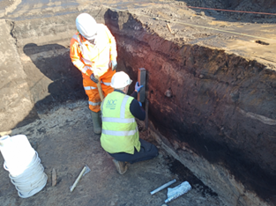
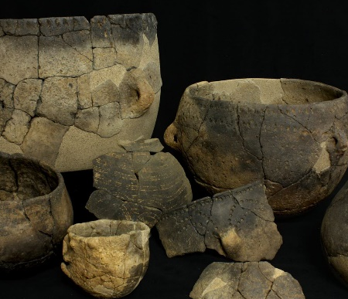
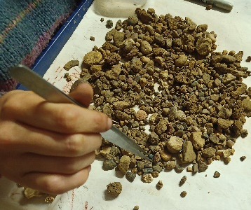
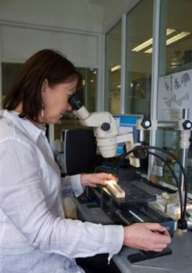
What is Archaeology?
Archaeology is the scientific study of human history and prehistory through the excavation of sites and the analysis of physical remains
Where no other records exist, it is often the only source of information about previous occupation of an area from the earliest inhabitants many thousands of years ago to more recent times
It is not only the study of physical structures, but also artefacts such as jewellery, pottery, coins, fabrics and skeletons
Along with ecofacts such as bone, charcoal, pollen, seeds, shells and wood
Notes:
Archaeology is the scientific study of human history and prehistory through the excavation of sites and the analysis of physical remains
**Hit button**
Where no other records exist, it is often the only source of information about previous occupation of an area from the earliest inhabitants many thousands of years ago to more recent times
**Hit button**
It is not only the study of physical structures, but also artefacts such as jewellery, pottery, coins, fabrics and skeletons
**Hit button**
Along with ecofacts such as bone, charcoal, pollen, seeds, shells and wood
Many ecofacts are not visible to the naked eye so we take soil samples from archaeological features which are then processed by environmental specialists to analyse if any ecofactsare present
They can provide us with valuable clues to how people lived, such as what they ate, what the environment was like at the time, along with dating information where other artefacts have not been present
Even a simple snail shell can tell you quite a lot about the environment of a site

Slide 4
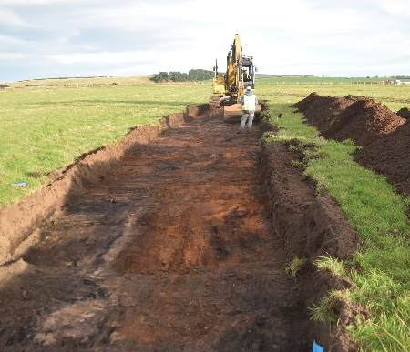
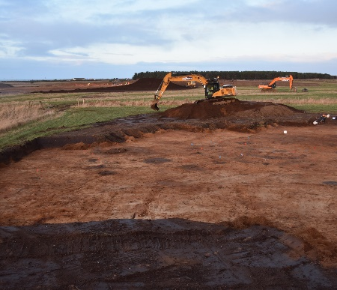
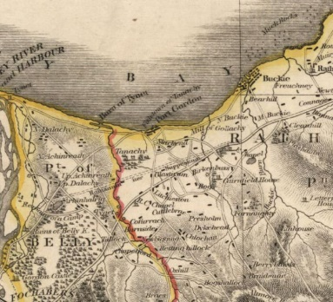
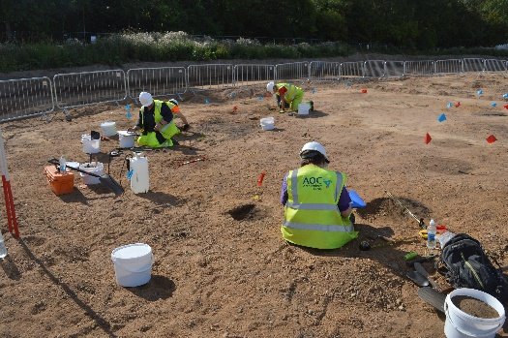
Why and How Do We Do It?
The majority of archaeological work is only carried out due to development and redevelopment in the local area
As part of planning consent developers may be asked by the council archaeologist to carry out an archaeological investigation which usually involves a combination of the following techniques
Non-invasive investigations:
  Desk based assessments, Fieldwalking, Geophysical surveys and Historic Building Recording Surveys
  Desk based assessments, Fieldwalking, Geophysical surveys and Historic Building Recording Surveys
  Desk based assessments, Fieldwalking, Geophysical surveys and Historic Building Recording Surveys
  Desk based assessments, Fieldwalking, Geophysical surveys and Historic Building Recording Surveys
Invasive investigations:
  Evaluations, Watching Briefs, Strip Map Record and Excavation
  Evaluations, Watching Briefs, Strip Map Record and Excavation
  Evaluations, Watching Briefs, Strip Map Record and Excavation
Notes:
The majority of work we do is only carried out due to the development and redevelopment in the local area
**Hit button**
As part of planning consent a developer may be asked to carry out an archaeological investigation which usually involves a combination of the following techniques
**Hit button**
Non invasive investigations combine both fieldwork and office research
**Hit button**
Desk based assessments are the starting point for all archaeology work and are a way of determining what is around us from existing records.
This can involve looking at the history of a site through written records or historic maps of an area, along with looking at aerial photographs for evidence of cropmarks
Identifying previously known sites and excavation work nearby to determine what we could potentially find
**Hit button**
Occasionally fieldwalking is carried out where we walk across a development area to see if there are any previously unrecorded upstanding remains that will be affected by the development such as old buildings, standing stones etc.
**Hit button**
Geophysical surveys are used to identify potential features underground based on the signal intensity produced by equipment
**Hit button**
We also carry out historic building surveys were we are recording the structure as a whole and how it has changed over time through the change of features such as blocked doorways and wall remnants
**Hit button**
Invasive investigations occur when breaking ground
**Hit button**
There are generally two types of initially used – Evaluations and watching briefs
Evaluations involve the excavation of trenches across of a percentage of the development area to determine if any archaeology is present – this was the initial technique used at the Portgordon site. If significant features are uncovered a 2nd phase of work may be required
Watching briefs are carried out where known archaeological deposits may be disturbed or destroyed. An archaeologist monitors all stripping across a development area to ensure that any archaeological remains encountered during groundworks are identified, investigated and recorded before development
**Hit button**
Following of from these techniques more in depth excavations may occur either through targeted excavation in large areas of land through strip map and record or full scale excavation – this is usually carried out for remains of the highest archaeological significance
AOC has conducted a variety of different archaeological investigations across the Portgordon area form carrying out watching briefs for new pipeline projects to historic building recording
The information gained from these investigations provides us not only with a picture of the changing history of the individual sites but allows us to build a bigger picture of what life was like in the area from prehistory until present day.

Slide 5
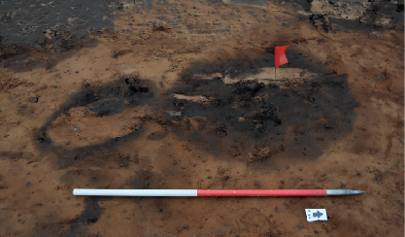
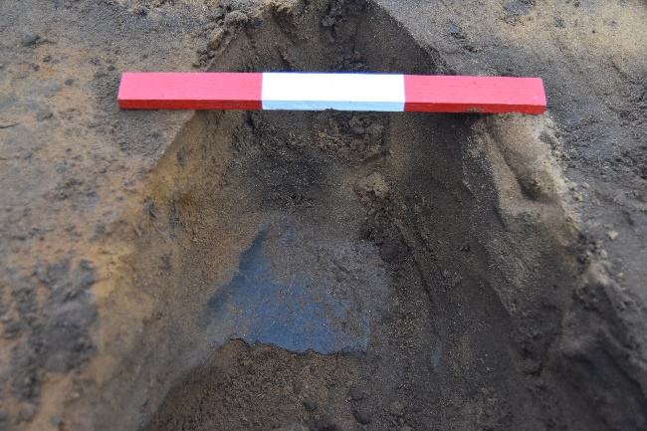
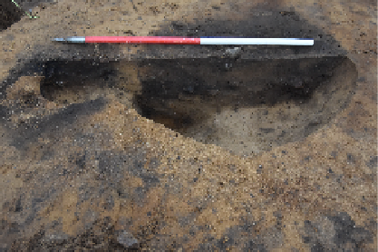
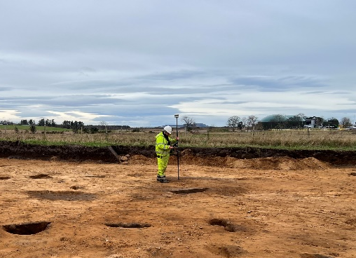
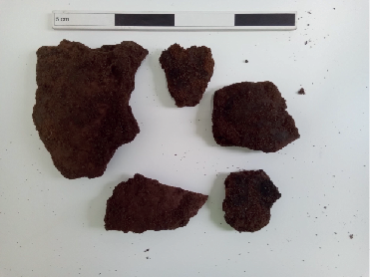
Excavation of a Neolithic Pit
Notes:
When archaeological features are encountered we follow a systematic process of excavation and recording
Here we have an example of the processes involved in the excavation and recording of one of the pits at Portgordon
**laser**
This photo shows the feature prior to excavation, visible as a change in colour from the surrounding natural
In the case of pits etc we would excavate one half of the feature which allows us to create a drawn and photographic record of the soil deposited within.
Any significant items such as artefacts or stone arrangements found mid excavation are cleaned and photographed
**Laser**
– in this case a large fragment of Neolithic pottery was uncovered
**button**
Here we have a drawing showing a vertical slice or section through the excavated feature
**laser**
And here we have a drawing showing how the feature looks in plan view
**laser
Once the feature has been drawn its location is surveyed using precision GPS to tie all the data into Ordnance Survey National grid
**button**
A detailed written record of the pit cut and soil deposits is kept, recording the feature dimensions, relationship to other features, descriptions of what it looks like and any inclusions within the deposits removed

Slide 6
Prehistoric Activity Around Portgordon
Notes:
Before we examine the results of our investigations at Portgordon, we’ll have a brief look at the evidence of prehistoric activity in the wider landscape.
Whilst previous excavations have shown potential for buried archaeology within the Portgordon area, very little evidence of prehistoric activity has been identified.
The majority of archaeological excavations undertaken, including previous work by AOC adjacent to Portgordon Maltings and Mains of Tannachie, have mainly revealed evidence of medieval/post medieval activity. Typically evidence of more widespread prehistoric activity is seen towards the west of Moray.
With significant multi-period prehistoric settlement, agricultural and metal working sites located at Clarkly Hill, Burghead; Dykeside, Birnie and Lochinver Quarry, Elgin.
Our recent work at Portgordon has contributed greatly to our understanding of how people were using the landscape during the prehistoric period in an area which has previously been a bit of a blank canvas.
Providing us with a snapshot of the potential for unidentified prehistoric remains within the area.
As land around Portgordon is predominantly used for agricultural purposes, there is great potential for undisturbed in situ archaeology sites (provided they have not been lost due to modern farming activity).

Slide 7
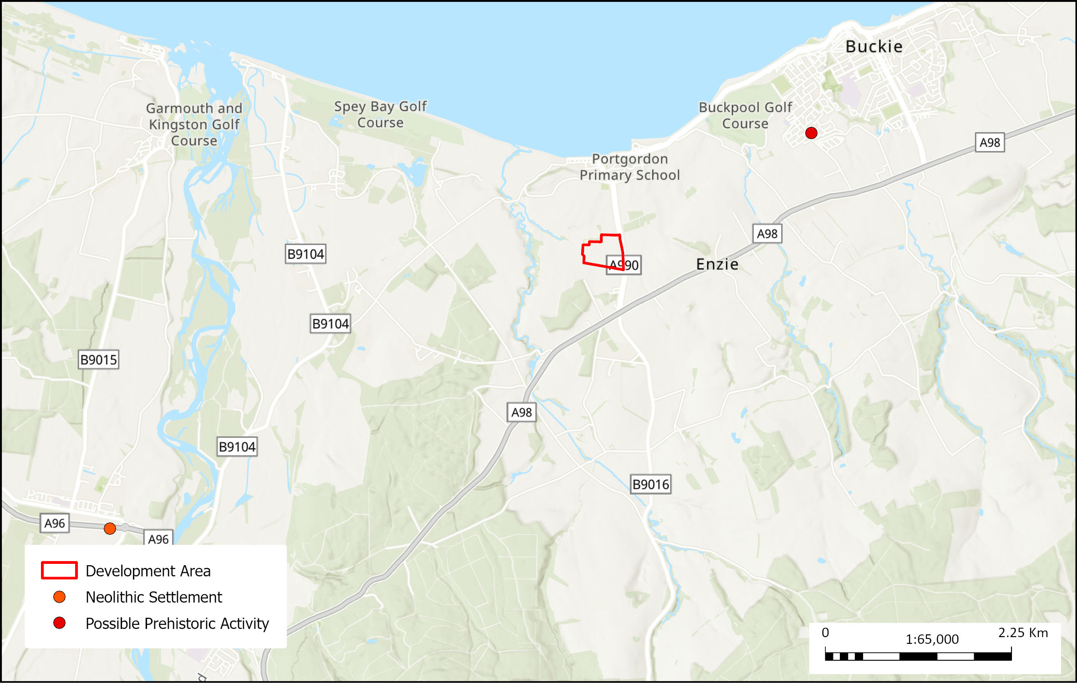
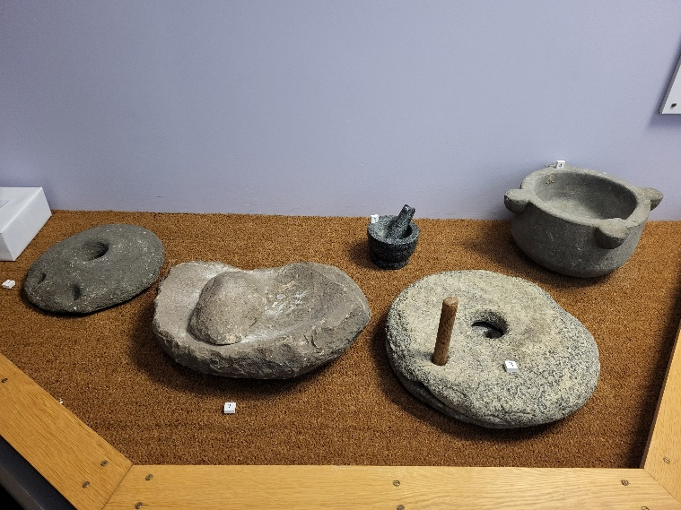
Prehistoric Excavation Sites
Notes:
Only two possible prehistoric sites have been excavated within 5km of the Portgordon site to date. Barnhill Road in Buckie and during the works for the Fochabers bypass at Mosstodloch
Barnhill features were predominantly medieval-post-medieval however a possible saddle quern was identified within the topsoil that may be prehistoric in date.
**Button
A saddle quern is a stone tool used for grinding various types of grain and were first used in the neolithic era – here’s a noce example of querns stones on display at Elgin Museum
**button
Mosstodloch investigations showed a multiperiod settlement site including an Early Iron Age ring-ditch roundhouse and associated features along with evidence of Early Neolithic Carinated pottery within several pits suggesting a long-term prehistoric activity in the area

Slide 8
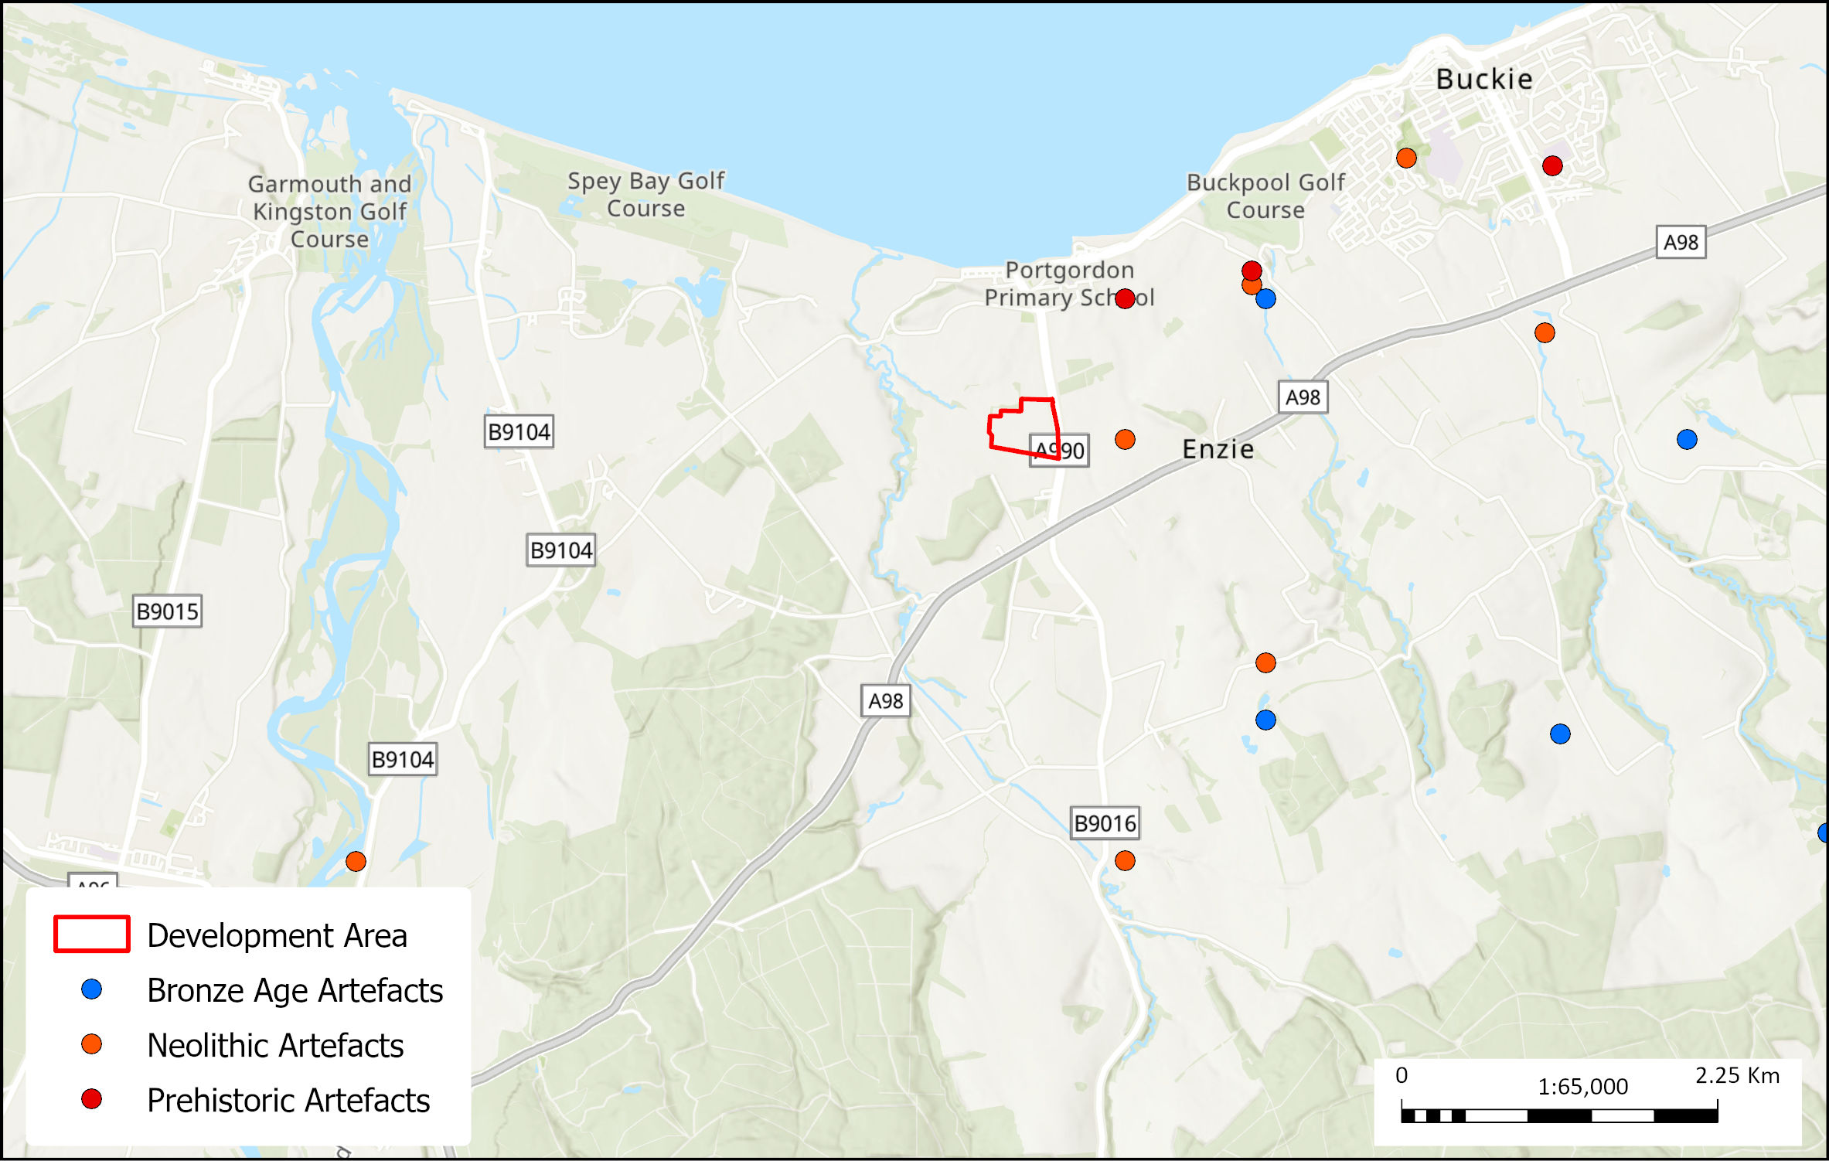
Prehistoric Artefact Locations
Notes:
Along with excavations, evidence of prehistoric activity is also recorded by the location of artefacts. These locations (or find spots) aren’t necessarily recorded as part of an archaeological investigation. Many find spots are identified just by a member of the public or land owner coming across something that has been disturbed and exposed either by farming activities, natural erosion or even digging in your own garden.
If you do find something that looks archaeologically significant it’s always good to speak with an expert so that the location can be recorded in the historical record.
Only two prehistoric find spot locations have previously been recorded within 1.5km of Portgordon
Two finely polished white flint axes and one claystone axe, thought to date to the neolithic period, were recorded to the east of the maltings site around
A collection of flint implements were recorded to the southeast of Portgordon which are believe to be prehistoric in date
A larger collection of axe-heads, flints and pottery dating from Neolithic to Bronze age period have been identified towards Buckie

Slide 9
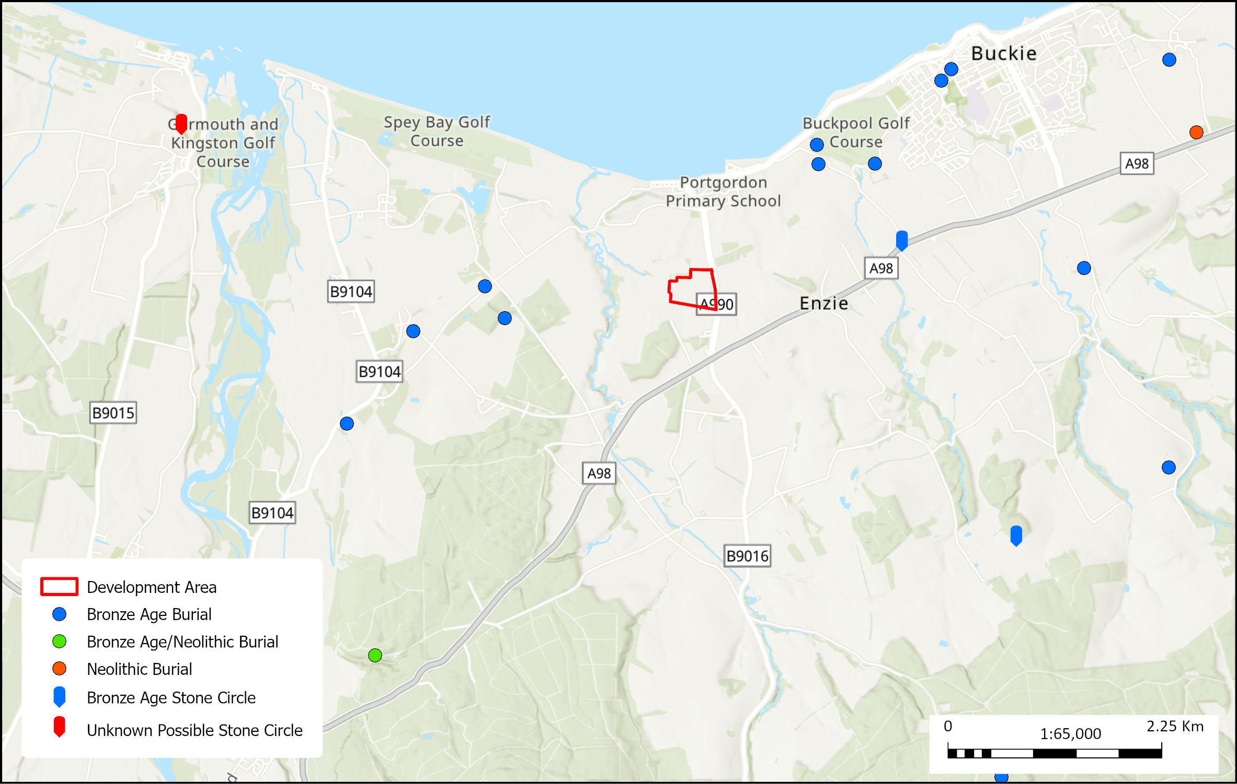
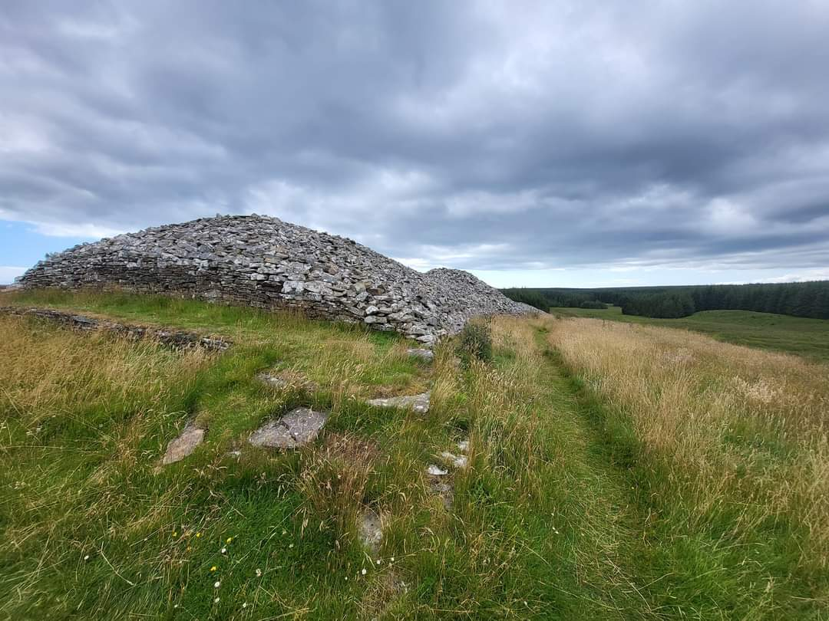
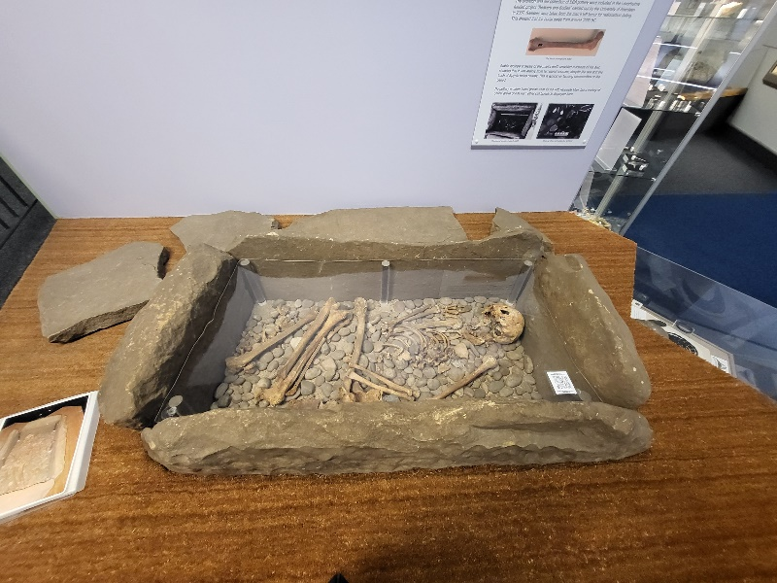
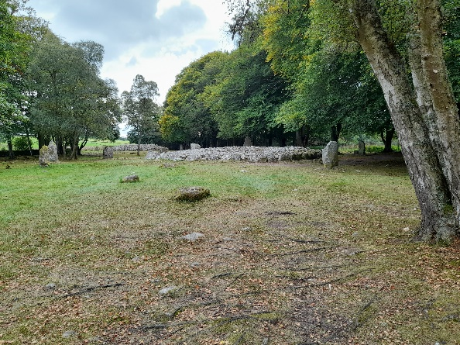
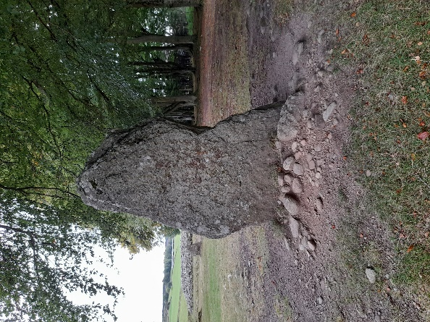
Prehistoric Ritual Activity
Notes:
In the areas surrounding Portgordon a number of Bronze Age and Neolithic burials and ritual activity sites have been recorded.
Many of these sites were identified in the 19th Century with only written records of their approximate locations available.
The sites primarily consist of burials in the form of cairns and cists and ritual activity in the form of stone circles.
**button**
Cairns come in a variety of shapes and sizes, they consist of a human-made pile of stones and can be used as either a boundary marker, memorial or burial site
**button**
A cist is a small stone-built coffin like box used to hold the bodies or ashes of the dead – this is a nice example that can be seen in Elgin Museum
**button**
Stone circles – a ring of upright stones sometimes surrounded by a ditch dating from neo to early ba.
**button**
Famous examples Callanish, Avebury, stone henge – here is an example of one surrounding a one of the clava cairns near inverness
The presence of such considerable prehistoric burial and ritual activity would suggest that more significant evidence of occupation should be present within the area

Slide 10
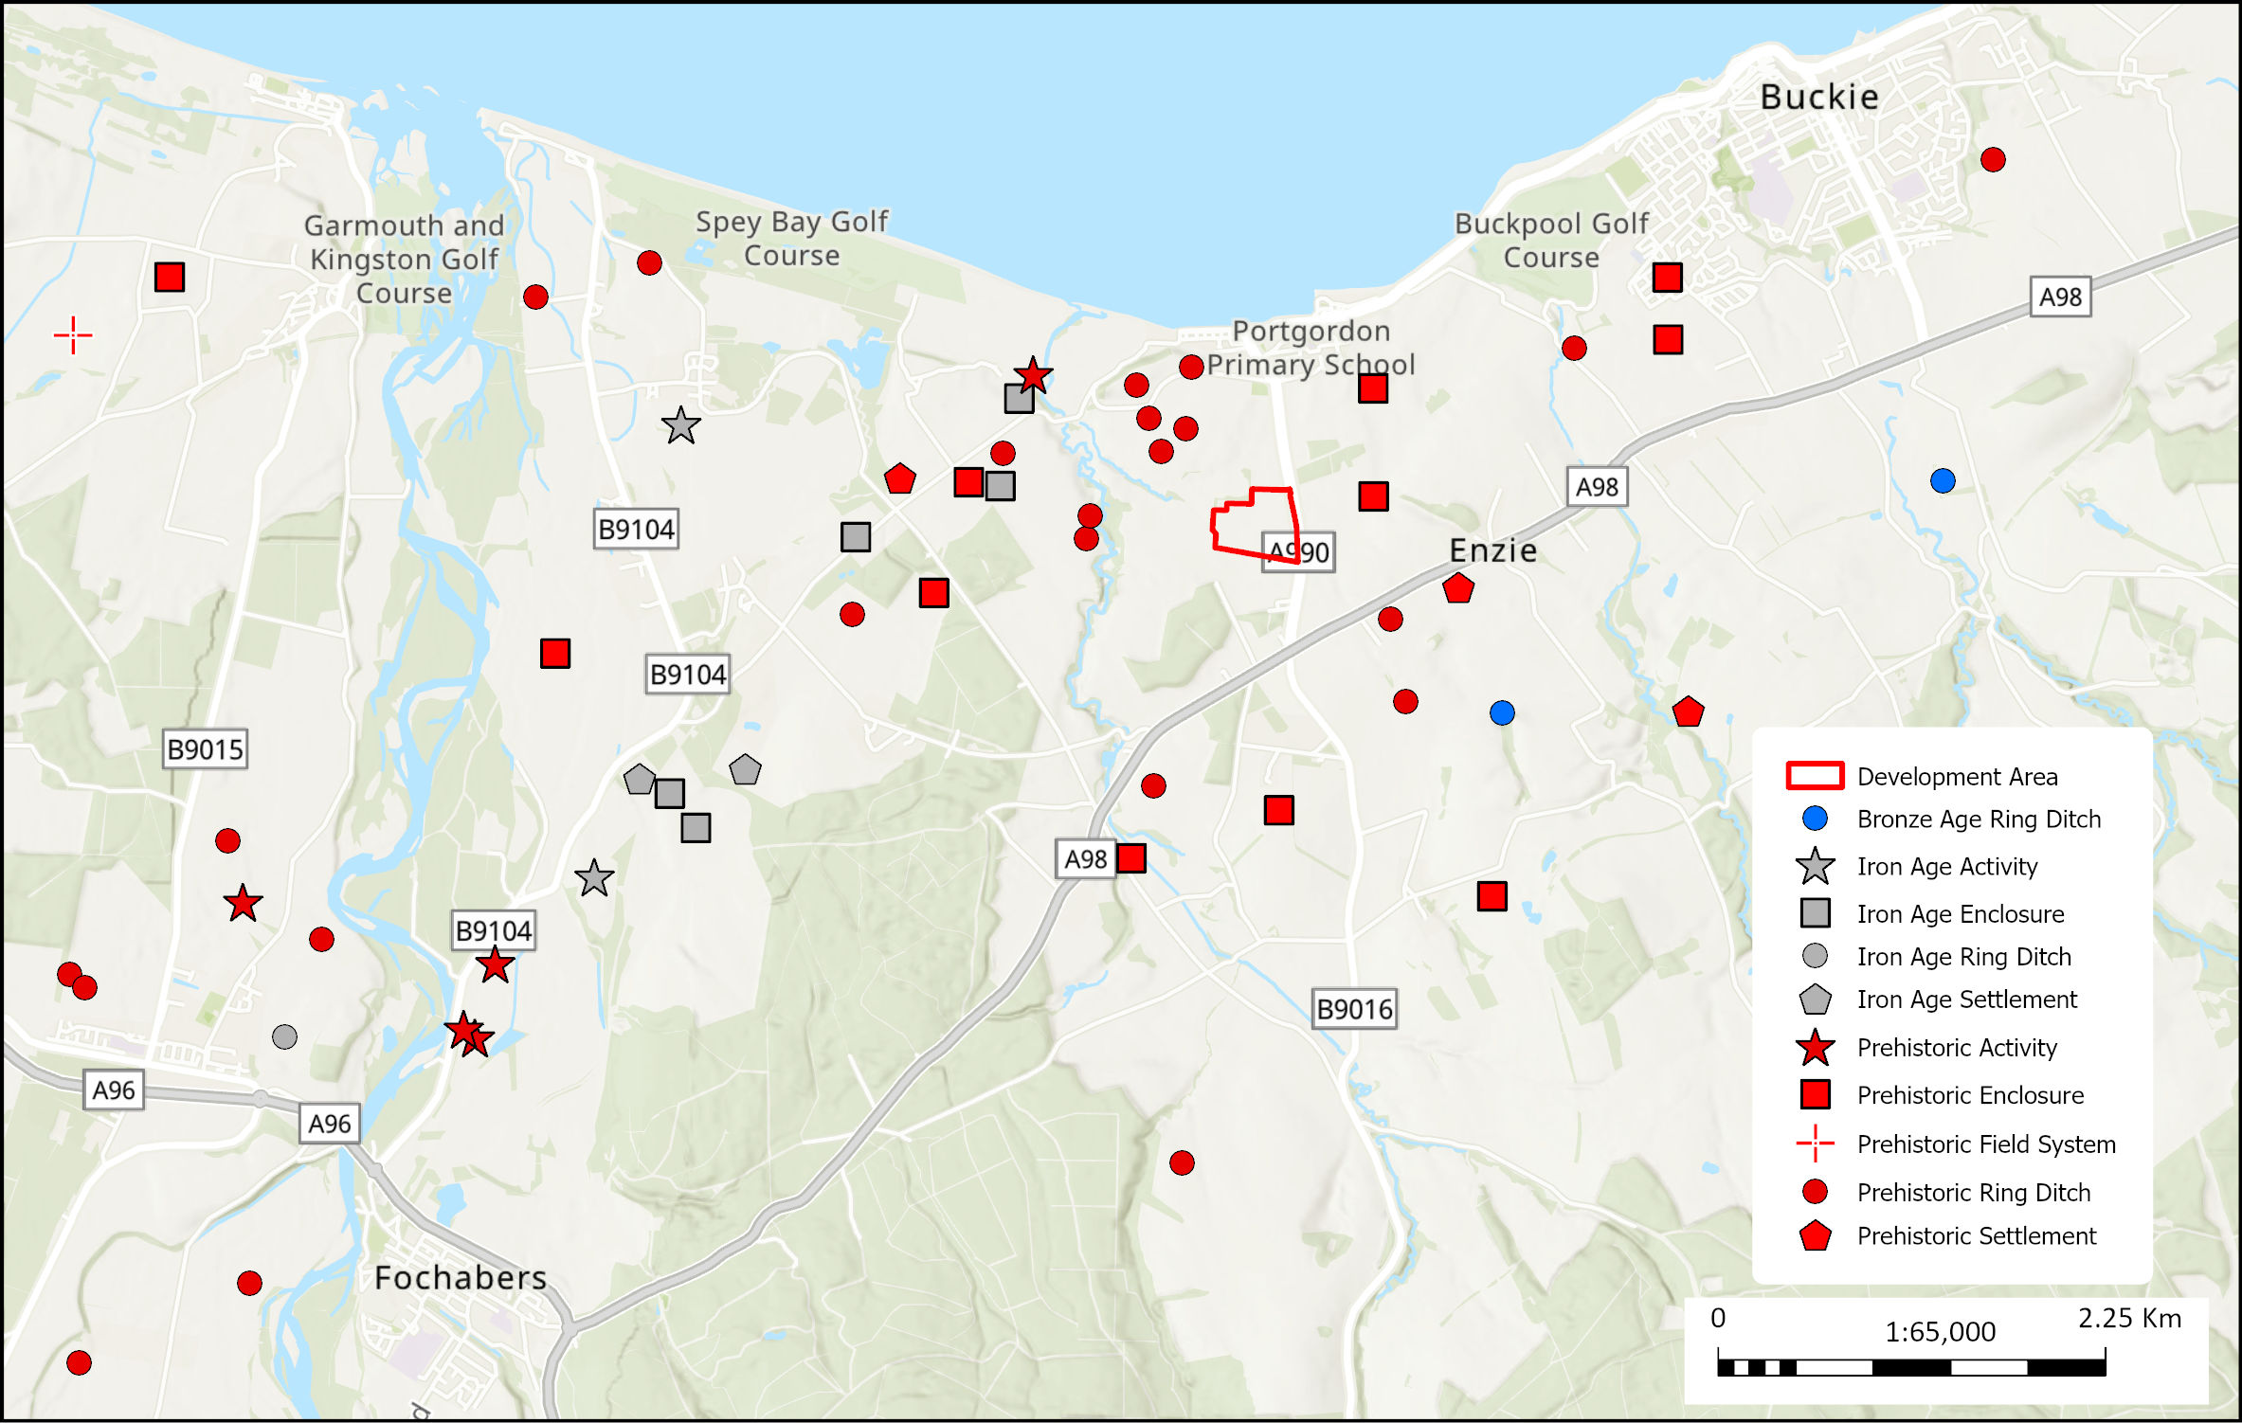
Prehistoric Cropmark Locations
Notes:
Whilst the evidence for prehistoric activity is limited to a few confirmed locations, there is widespread evidence of possible prehistoric activity recorded through aerial photography.
Cropmarks occur where archaeological and natural features affect the growth rate of cereals and other planted crops above them.
In the case of sub-surface features such as ditches, pits and postholes, the greater depth of soil can often lead to enhanced growth of the crop immediately above them, which produces darker patterns within the crop.
Built up features such as walls and floor foundations can inhibit the growth resulting in poorer quality crop growth, producing lighter areas within the crop
The patterns created can be seen from above during aerial reconnaissance, the results of which depend on the ground conditions and stage of growing season.
Button
Here is an example of a site near alves. Following an evaluation it revealed that the lighter areas represented a rise in the natural gravel terrain with the darker patches seen towards the building representing an area of deeper hillwash
button
Numerous cropmarks showing potential settlement and agricultural activity have been identified across the wider Portgordon area.
Unfortunately, the opportunity to investigate the majority of the crop marks visible is limited by funding and current land use (farmers aren’t generally keen on us digging up their land for no reason).
Archaeology is a destructive science and primarily the only way we get the opportunity to investigate sites is as part of the planning process. Without the cooperation of developers during the planning process many sites would never be found.

Slide 11
Overview of Archaeological Investigation at Portgordon

Slide 12
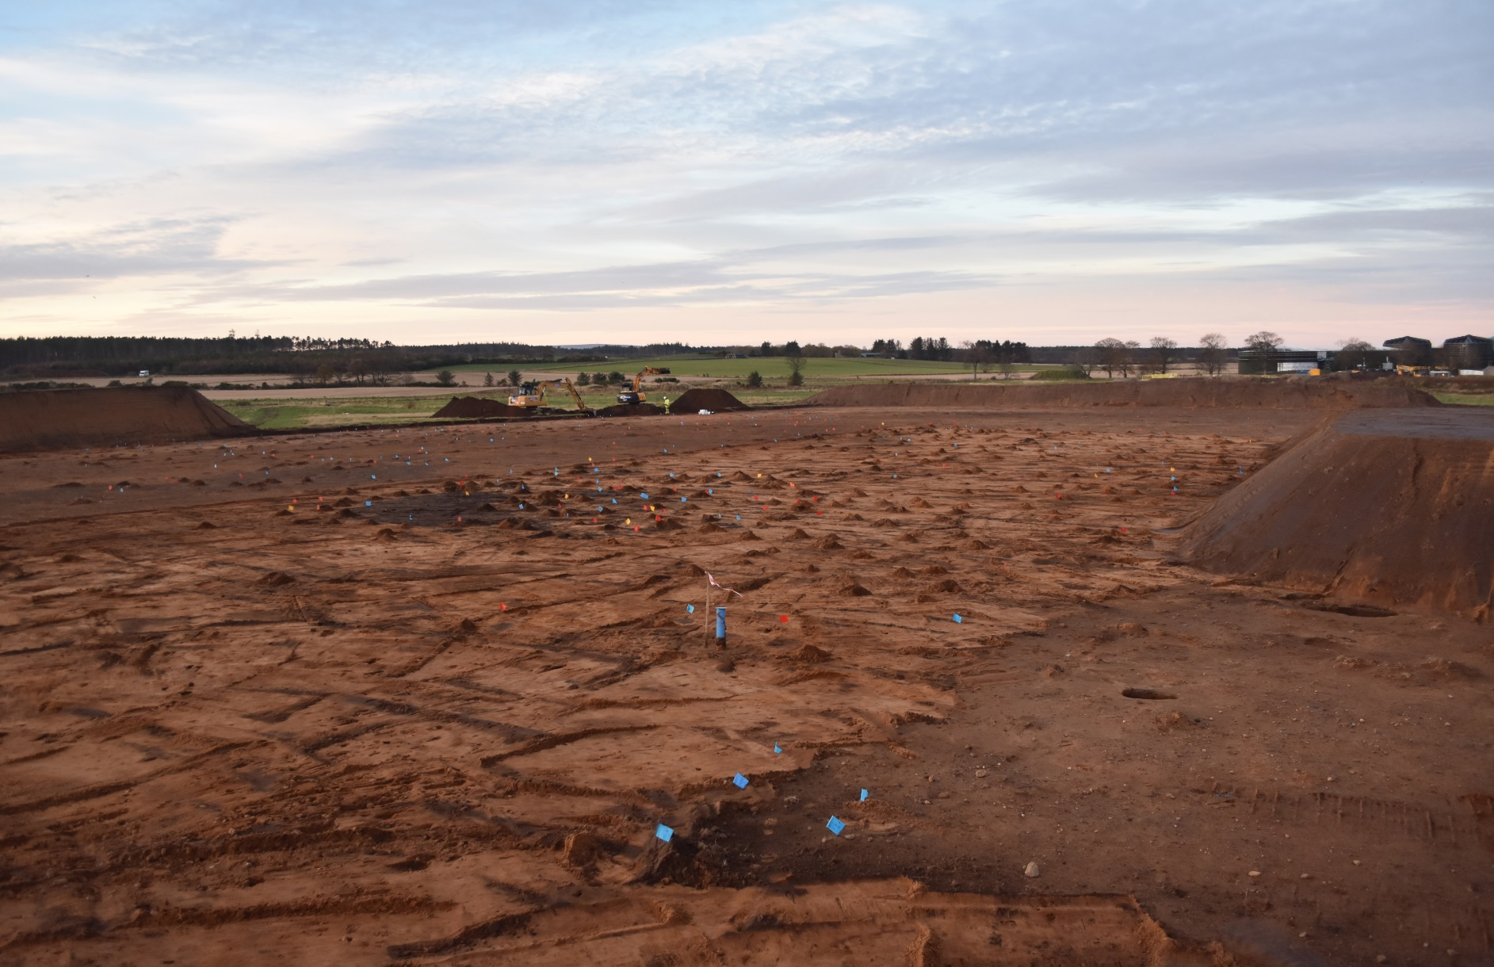
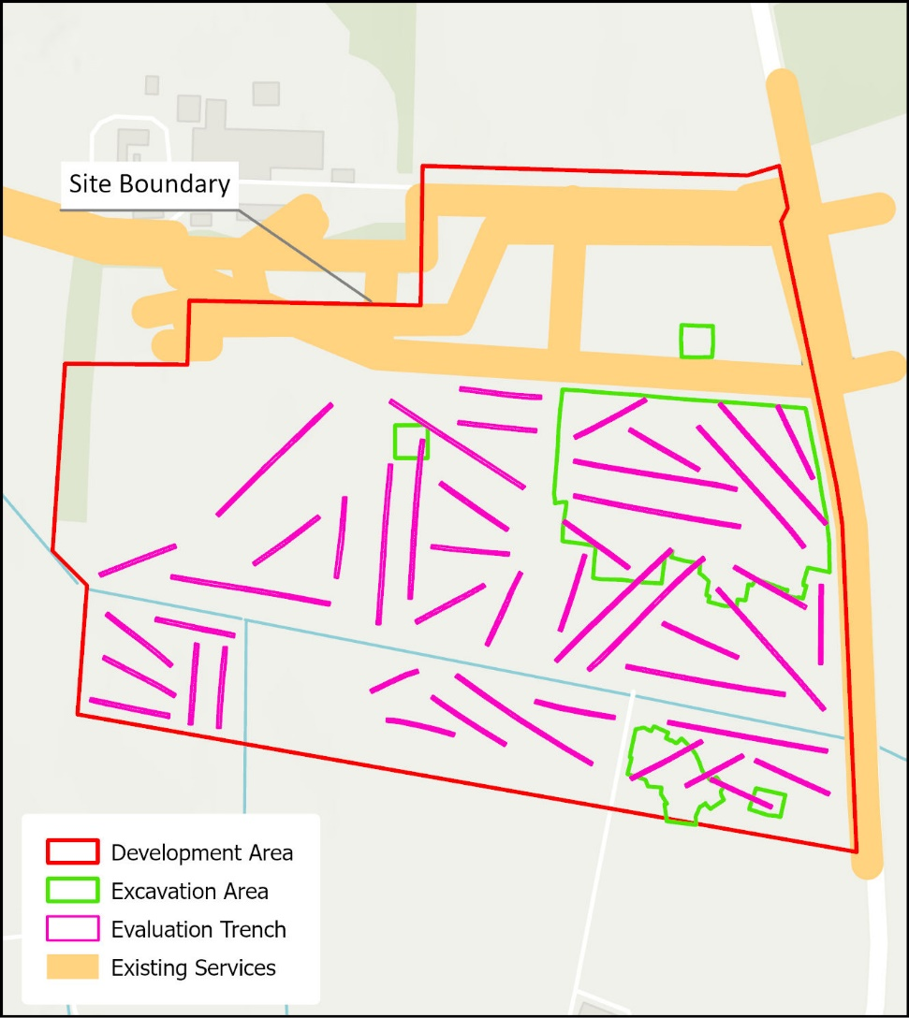
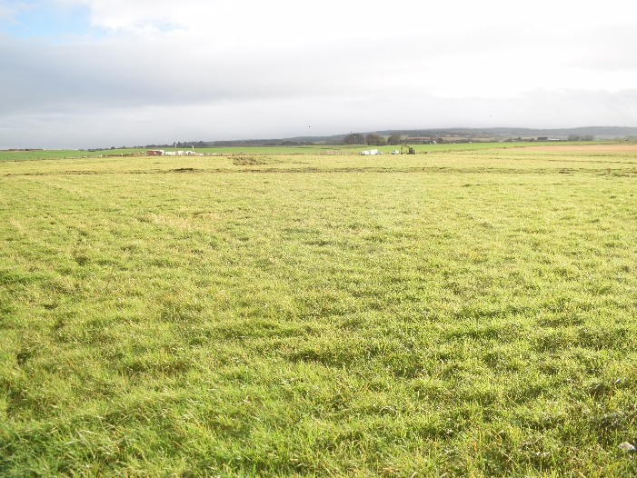
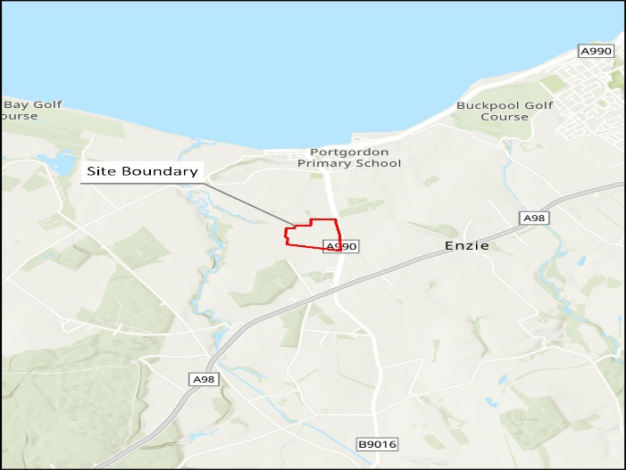
Site Location
Notes:
The site is located on the south side of Portgordon maltings and to the west of the A990 in gently sloping arable farmland.
Initial investigations started in June 2022 with the 2nd phase of works being completed in March 2023
Initial investigations comprised the excavation of 46 evaluation trenches across the development area, with a 2nd phase of excavation taking place in areas where archaeology was identified during the evaluation
Two areas were excavated during the second phase of works comprising a large area to the northeast of the development area where the majority of features were uncovered and a smaller area to the southeast
An extensive number of features were uncovered across the excavation areas, mostly pits and postholes, with occasional ditches and spread materials
The vast amount of archaeology encountered came as quite a shock to all involved – I’m sure many of you will have seen the sea of flags visible from the road
It should be noted that the results seen here are based on our preliminary findings in the field. All soil samples and artefacts recovered during the investigation will be analysed by specialists to provide us with a better understanding of the site chronology and function

Slide 13
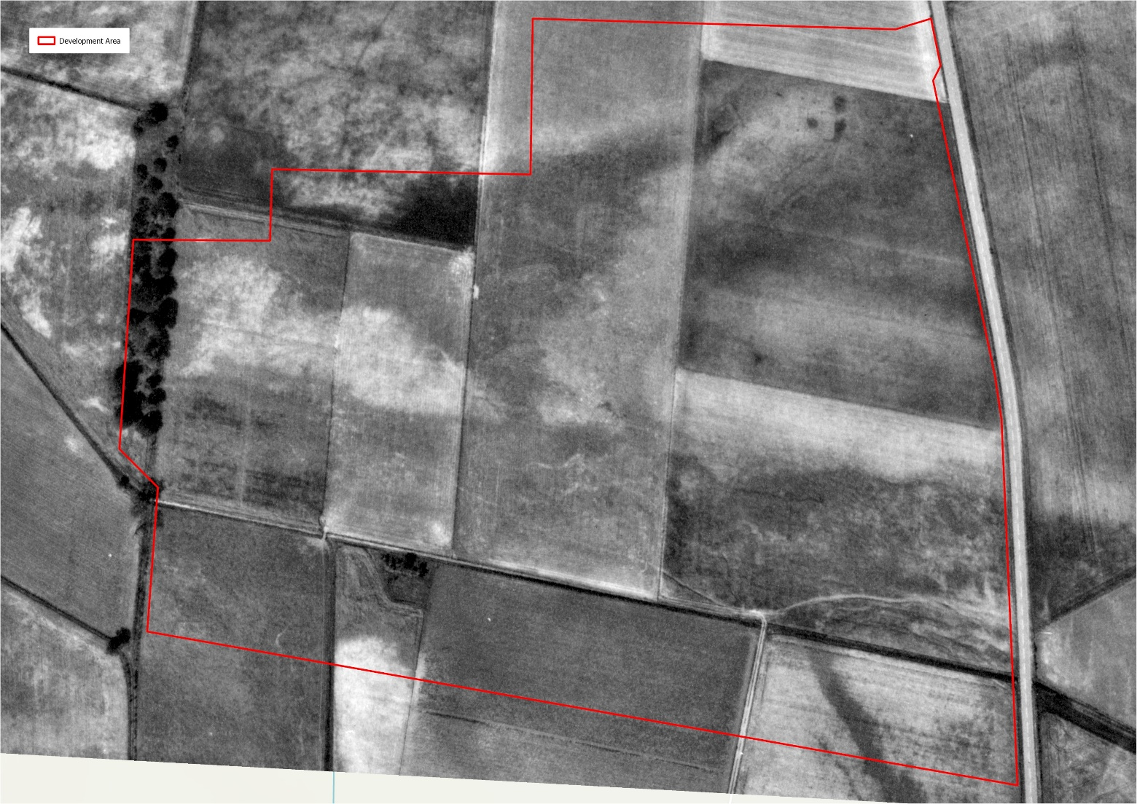
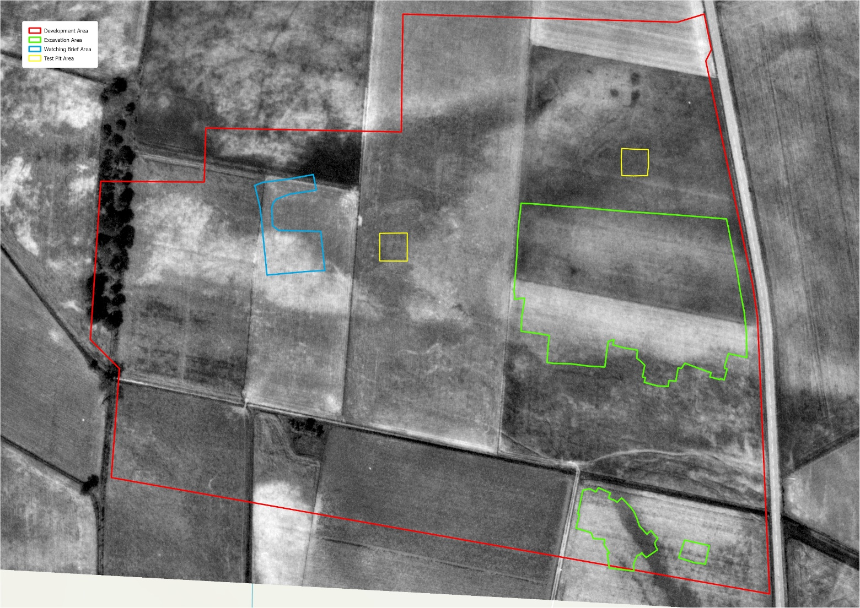
Aerial Photography
Notes:
Previous aerial photographs of the area showed little potential archaeology within the development area (It was predicted I’d only be there for 2 weeks!!)
The red line overlain on the aerial photograph represents the development boundary and as you can see there’s not many clear cropmarks within the area
The green lines represent areas that were investigated during phase 2
The yellow squares represent additional test pits excavated within previously excluded areas (nothing was found in them)
The blue line represents an additional watching brief area that was monitored at the time of phase 2 which revealed four post-holes likely of to be prehistoric in date
Without the cooperation of William Grant and Sons requesting an archaeological investigation in advance of development, we would never have known that this settlement existed.

Slide 14
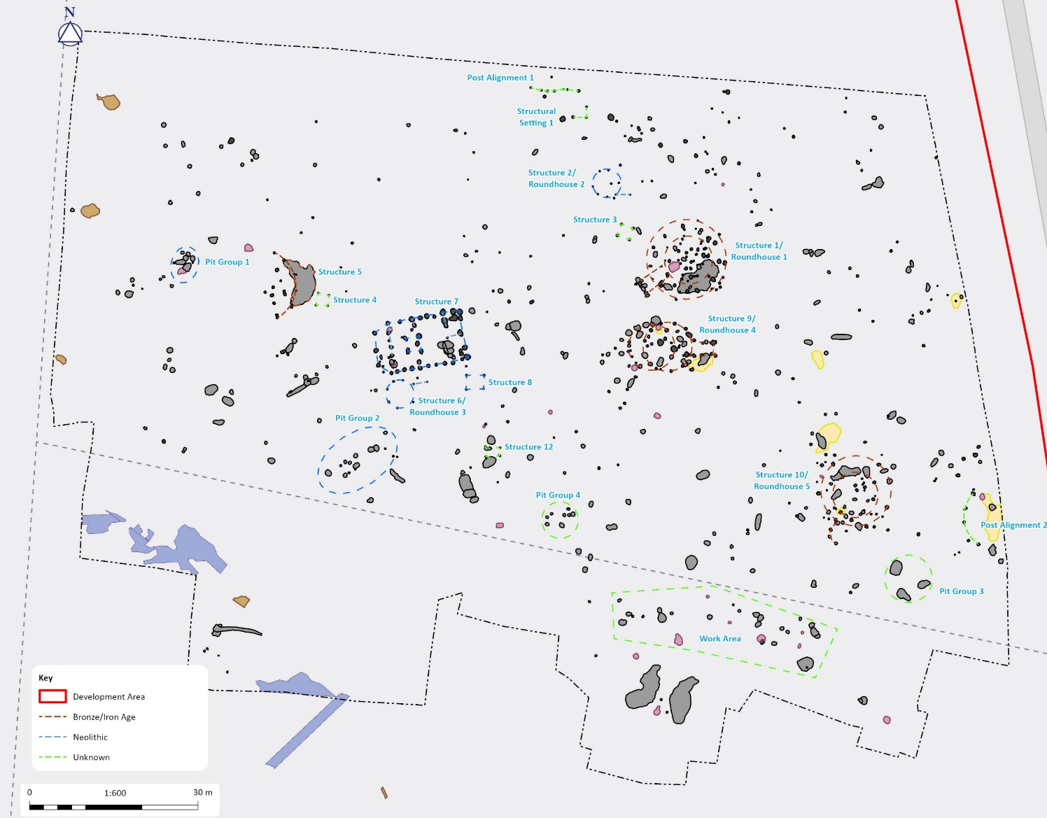
Archaeological Features North Area
Notes:
Here you can see a plan of the archaeological features identified in the north area.
This illustration shows how much archaeology was identified in this area
The north area contained the majority of the identified structures, these have been highlighted with dashed coloured lines, don’t worry about trying to identify structures as I shall be looking at these in better detail later on

Slide 15
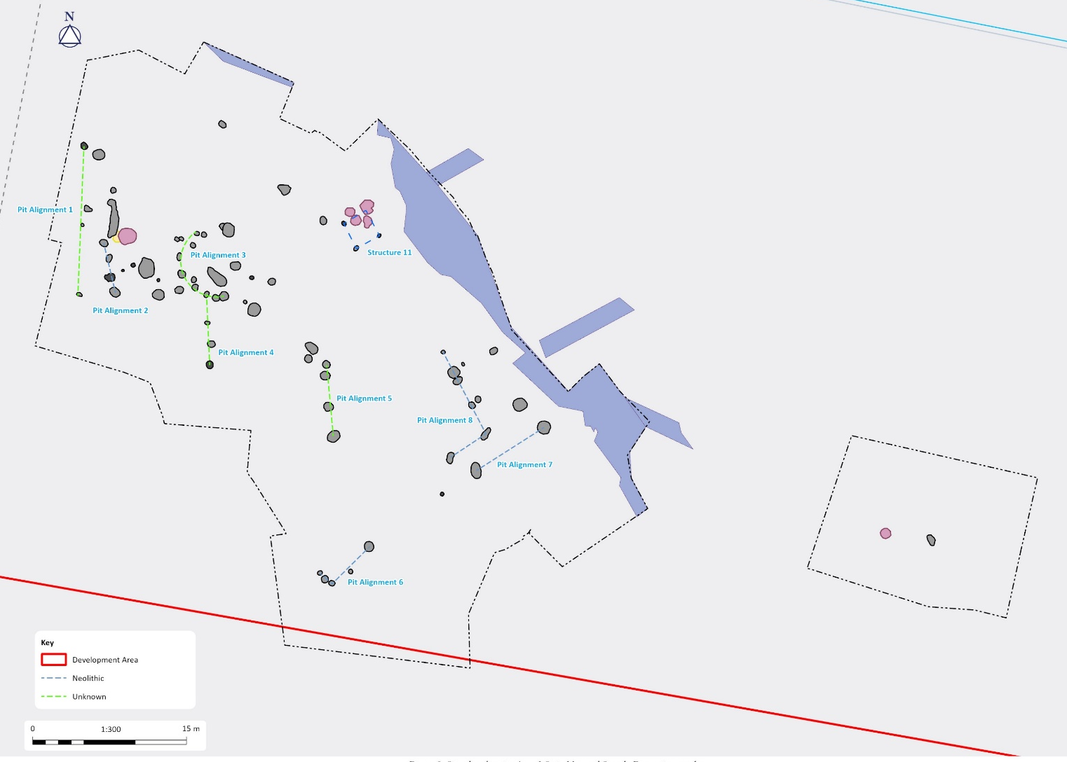
Archaeological Features South Area
Notes:
Here you can see a plan of the archaeological features identified in the south area.
There were fewer structures identified in the south area, it is likely that this area was used as a temporary camp or work area which is why we can’t see any clear structures

Slide 16
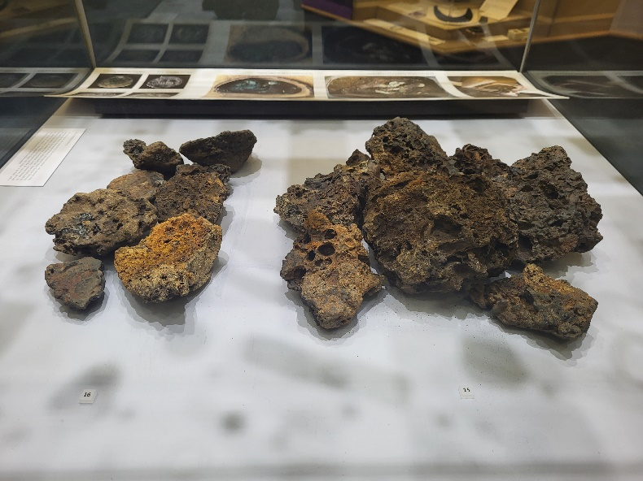
Summary of Features
1 Neolithic Timber Hall
7 possible roundhouses
2 cremation pits
5 four-post structures
3 Grain pits
35 possible fire-pit or hearth structures
1 area of metal working
5 pit groups/alignments
5 Ditch features
Notes:
During the investigation over 885 features along with deposits were revealed across the site, with 12 possible structures identified.
Evidence of settlement activity ranged from the Early Neolithic to Bronze Age and or Iron Age in the form of a potential neolithic timber hall, roundhouse and four-post structures.
Timber halls are large rectangular high-status buildings constructed largely of wood, often described as large roofed houses, which are generally thought to represent neolithic dwellings
Roundhouses are circular or sub-circular domestic buildings, usually containing one room. They are largely constructed from timber posts with wattle and daub outer walls with a conical thatched roof and central hearth area
Evidence of ritual activity was present in the form of two cremation pits
By the bronze age it was more common to cremate bodies and bury them in pits
Evidence of small scale industry can also be seen on site with presence of grain pits and four-post structures and fire-pits containing metal working waste
Grain pits along with grain drying kilns typically contain a thin layer of burnt material towards the base where burning in-situ has occurred – often associated with the sterilization of pit linings for storage
Four poster structures are roughly squared structures with timber posts located at the four corners. They are typically thought to be used for grain drying or possibly even mortuary practices.
A number of fire pits containing an abundance of charcoal and slag were identified on the site. Slag is a bi-product of smelting ores – here’s some slag from elgin museum
A number of further pit groups and ditches were also evident on site but it wasn’t possible to identify any clear function for them during the excavation

Slide 17
Neolithic Activity
(c.4900 – 2000 BCE)
Notes:
The neolithic period saw the transition from nomadic hunter gatherers to settled communities and the dawn of farming.
During the excavation process it was possible to give a preliminary date of the Neolithic Period to several structures and groups of features due to the presence of distinct artefact types such as fragments of Neolithic Grooved Ware and Early Neolithic Carinated Ware pottery.
Carinated Ware represents some of the earliest type of pottery that is found in Scotland, so its discovery within the site is very significant
On occasion features were assigned a preliminary date based on their close proximity to/similar morphology with these dated features – these may be subject to reinterpretation following post-excavation analysis.

Slide 18
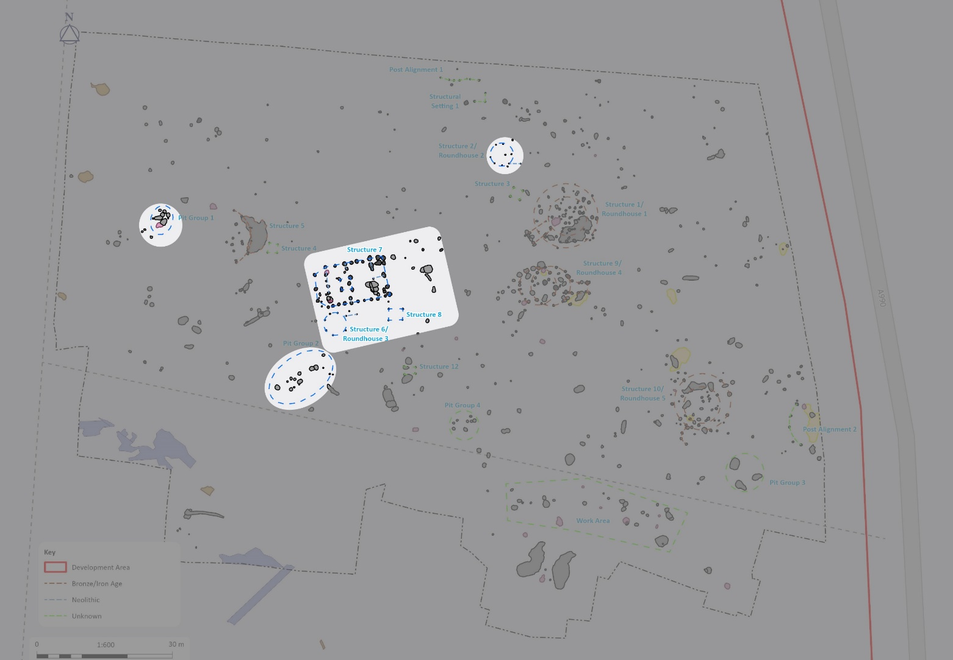
Neolithic Features North Area
Notes:
Highlighted are Structures 2, 6, 7, 8 and pit groups 1 and 2

Slide 19
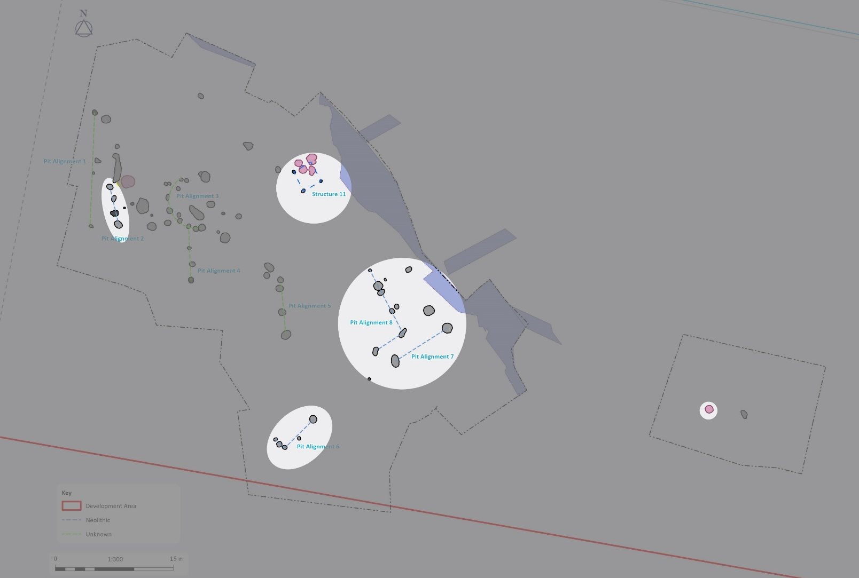
Neolithic Features South Area
Notes:
Highlighted are structure 11 and pit alignments 2, 6, 7, 8 and a fire pit located to the east identified in the evaluation containing a fragment of neolithic grooved ware pottery

Slide 20
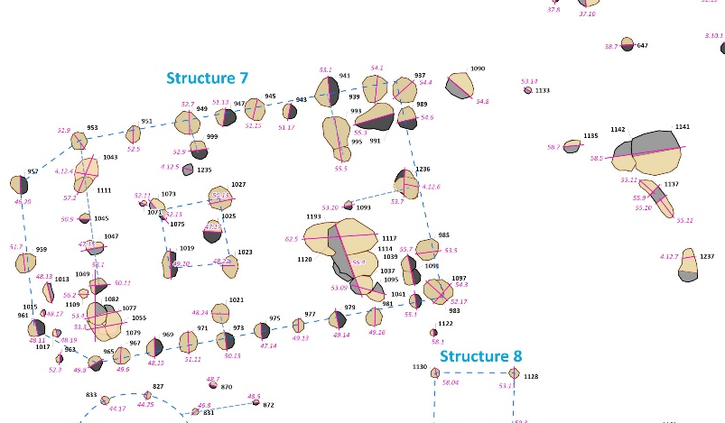
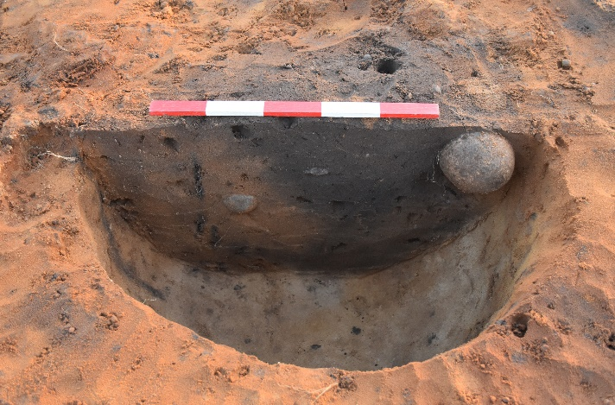
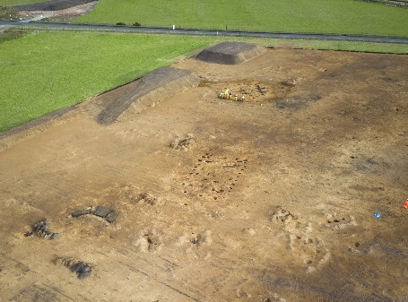
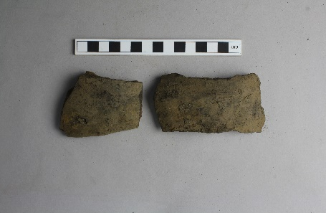
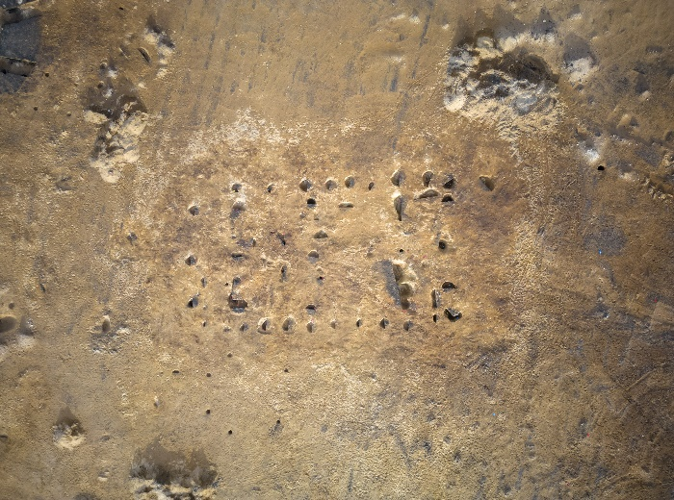
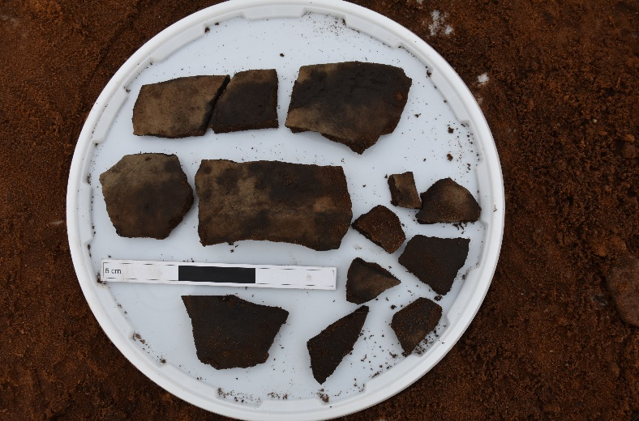
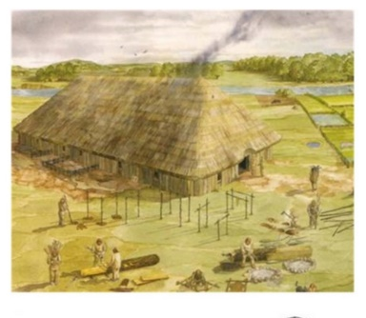
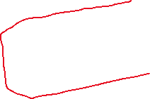



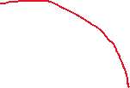

Structure 7
Notes:
Structure 7 is probably the most exciting feature on site. It comprised a rectangular timber-built structure and has been interpreted as a Neolithic Timber hall. To date only 12 neolithic timber halls have been identified across Scotland through aerial reconnaissance and excavation.
This is the only timber hall excavated in Moray. A second possible timber hall has been identified through crop marks at Newton of Dalvey outside of Forres.
Aligned roughly ENE-WSW the structure measured 16m in length and 9m in width.
The outer extents were defined by a series of large postholes narrowing to a trapezoid at the west end.
The interior was sub-divided into three distinct areas by rows of NNW-SSE aligned postholes with further internal features including a four-post structure
The external postholes were evenly spaced and generally sub-circular in plan with steep sides and relatively flat bases
A central line of posts was identified which may have been installed to allow for additional roof support or served as a partition within the structure
Evidence for surviving post-pipes and packing material were visible within the majority of the post-holes along with recut features demonstrating structural repair and reuse (use red line on pic)
Pottery fragments, lithics and worked stone were identified within several of the post-holes including a large collection of early neolithic carinated ware fragments
A series of deep intercutting pits was located towards the southeast corner of the structure, however at present the function of these pits is unclear, hopefully further post-excavation analysis will provide a clearer picture of their function
Neolithic timber halls are a type of early neolithic structure associated with early farming generations in Scotland. The structure identified here is slightly smaller than those previously identified Neolithic timber halls in Scotland which are usually 19-24m in length. However, features located to the east end of the structure may have formed a yard or addition to the structure giving it an extended length of 25m
An artists impression of timber hall is shown in the bottom right corner

Slide 21
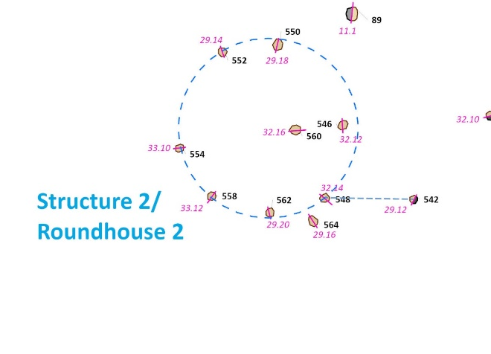
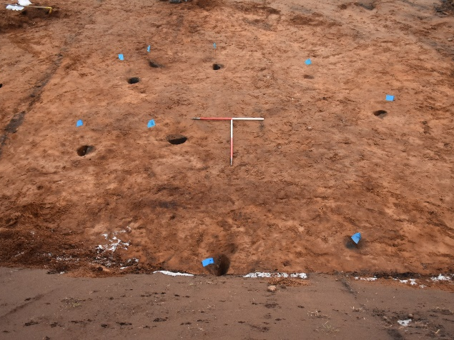
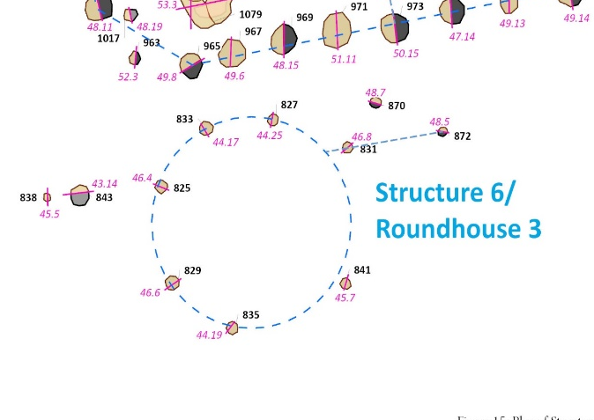

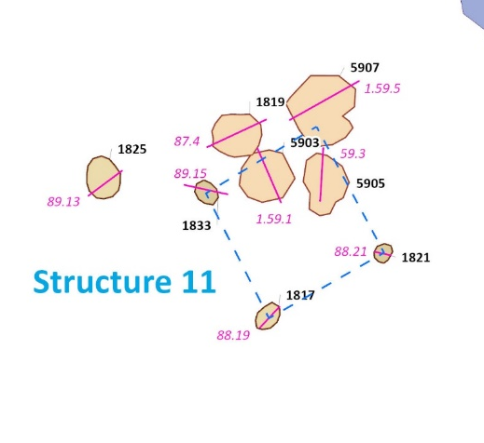
Structures 2, 6, 8 and 11
Notes:
Along with the timber hall four more potential neolithic structures were identified in the north area. Whilst none of these contained any ceramics, the close proximity to the timber hall and general morphology would suggest they are neolithic in date.
Two possible neolithic roundhouse structures were identified during the excavation in the North area of the site.
As circular structures are not common in the Neolithic period they may represent smaller dwellings, enclosures or workshop areas.
Both structures comprised a ring of postholes with an internal diameter of approximately 5m and the possible remnants of a porch structure to the east
Two possible neolithic four-post structures were also identified during the excavation. Pits containing neolithic pottery were located within the confines of Structure 11 providing a neolithic date for the structure.
Three further four post structures were evident across the site however there were no artefacts available at this stage to provide a preliminary date for them

Slide 22
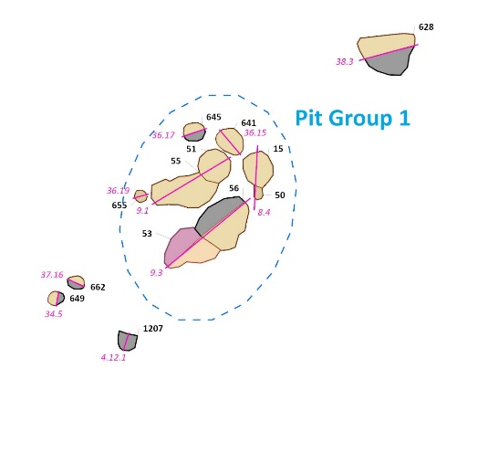
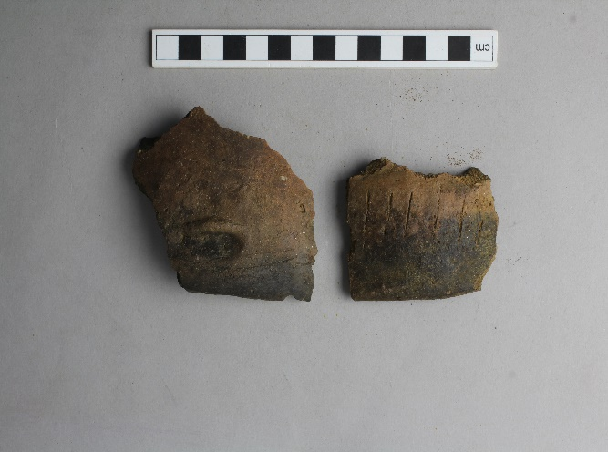
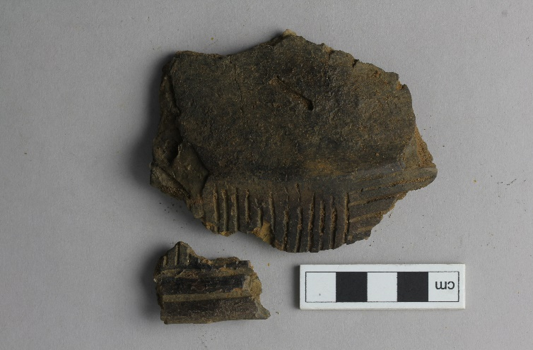
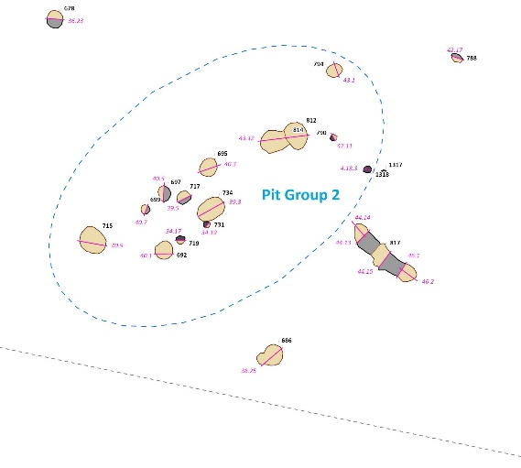


Waste Pits
Notes:
Two neolithic pit groups were identified in the north area containing fragments of decorated neolithic pottery
Fills within the pit groups were similar in morphology and contained evidence of dump material it is likely that they represent waste pits
Neolithic pit activity is widespread across Scotland and can represent evidence for both ritual as well as domestic activity

Slide 23
Bronze/Iron Age Activity
(c.2000-800 BCE, 800 BCE-400 CE)
Notes:
Bronze/iron age activity was identified through three roundhouse structures within the site.
They all had post-rings and measured between 8.5-14.25m in diameter which is within the typical range for those seen in the bronze/iron age
Remnants of ditches were noted as part of the threes structures – these are often created through repeated wear and trampling rather than being structural – a feature that can be found in examples from the early BA to IA
Whilst the roundhouses all shared some common features they left very different footprints, this may represent different construction styles or possibly that they were built at different times

Slide 24

Bronze/Iron Age Features North Area
Notes:
Highlighted are structures1, 5, 9 and 10

Slide 25














Structure 1
Notes:
Structure comprised series of pits/post holes forming three concentric ring of posts with evidence for internal supports and / or repair of the structure with intercutting features forming various different arcs.
The three post rings comprised:
an outer ring with a diameter of 14.25m – this is possibly the outer edge of the structure supporting a second wall or possibly the eaves of the roof
a central ring which is believed to be the main structure of the building with a diameter of 11.5m
inner ring roughly 8.5m in diameter with evidence of recuts indicates replacement of posts during lifecycle of roundhouse
A partial ring ditch was located to the south east – it was relatively shallow and contained two saddle querns
Entrance porch to southwest defined by postholes
An internal hearth feature located towards the centre of the structure containing frequent charcoal, burnt wood, heat affected stone and occasional quartz fragments. Quartz can be used as a firelighter. Heat affected rounded stones may have been potboilers
Fragments of pottery and stone tools were recovered from the structure
Bottom right artists impression of a typical roundhouse

Slide 26






Structure 5
Notes:
Located to west of timber hall, comprises partial remains of ring ditch and arc of six postholes with internal features
The ditch contained evidence of in situ burning with heat affected sand, a charcoal rich layer towards the base and the remains of a burn timber post. Ditch stepped internally possibly to allow for drainage during use – typical roof run off
Eight further post-holes were identified within the internal area of the structure and contained bronze age pottery sherds
Remains of the structure to the west were likely lost due to modern agricultural activities

Slide 27









Structure 9
Notes:
Structure 9 comprised at least two overlapping round house structures.
The east roundhouse had a post ring diam of 8.7m with a rectangular entrance/porch towards the east formed by two lines of postholes and had a ring ditch to the southeast – a possible stone tool was identified in a spread of material covering the ring ditch. The spread was charcoal rich and possibly represents dump of domestic burning waste at the entrance to the roundhouse, deposited during use or following abandonment
West roundhouse had a post diameter of 8.2m and overlaps the east ring suggesting they would not have been in place at the same time, so it must have been earlier or later in date
Two cremation pits were recorded within the central part of structure 9
There may be more phases of occupation but it is difficult to determine the stratigraphy without further assessment of environmental remains

Slide 28








Structure 10
Notes:
Was a roundhouse structure located to the southeast of structure 9. It was formed of an array of post-holes and post pits, tentatively interpreted as forming two concentric post rings with internal and external features. The Internal ring was 8m in diam, whilst the outer had a diameter of 12.6m
No clear internal structures were identified, there was however an arc of postholes to the southwest which may represent a possible porch
To north a pit containing a large stone was identified. The purpose of the stone is unclear however the wear on the stone would suggest it had been subjected to rubbing over a long period of time, possibly by animal activity. It is possible that it originally stood upright
A slight hollow surrounding the pit may represent wear pattern caused by animals/people moving round the stone
Top general view of structure looking west
Middle - large stone in pit to north of structure 10
Bottom – large stone from pit

Slide 29
Other Prehistoric Activity
Notes:
Across the site there were several clusters of pits/postholes which whilst they had no clearly identifiable structure/function these were grouped together due to their close proximity and similar characteristics
Further analysis of the fieldwork results and site chronology will assist in understanding the layout of the structure

Slide 30

Undated Groups North Area

Slide 31

Undated Groups South Area

Slide 32





Grain and Waste Pits
Notes:
Numerous waste/storage pits were recorded across the site providing us with a glimpse into the daily lives of the inhabitants
The pits generally being located on the peripheral of the occupation areas (don’t really want your waste material too close to area of occupation)
Three large grain pits were identified within the north site, roughly oval in shape the pits all contained a lower fill consisting of charcoal and ash material suggesting burning in situ. Waste pits contained evidence of animal bone, broken ceramic fragments, slag and worked stone material

Slide 33





Work Area
Notes:
A number of fire pits containing fire cracked stone and charcoal were located in a possible work area – although they weren’t similar in construction the clustered appearance suggests they may be related
Evidence of whetstone along with quern stone fragment in the area may suggest use for crop processing
Two large features to south possibly represent the remains of burnt mounds/fire pits or an area used for large cooking/drying

Slide 34






Paleochannels
Notes:
Evidence of paleochannels were present across the site and show the remains of ancient waterways
The paleochannel towards the south of the site measured c7.2m wide and 1.4m deep. Within the channel it was possible to identify several layers of naturally accumulated silty sand representing the redistribution of deposits during the channel over time.
Evidence of human activity was seen in the presence of charcoal rich material, showing prehistoric activity nearby. Likely washed in during flooding of nearby activity and included ceramics along with bog iron ore
Bog iron was traditionally exploited during early metalworking activities for smelting due to its easy accessibility and reducibility
Further assessment of samples will give us a better understanding of the formation of the paleochannel over time and what the environment was like during the phases of occupation nearby
Giving us a better understanding of why people chose to live here over such a long period of time
The channel would have provided resources for everyday living, such as bog iron for metal working, food and water along with a means of transportation to the Burn of Tyney and onto the Moray Firth

Slide 35
Artefacts

Slide 36
Notes:
Here we have a few photos of some of the artefacts recovered during the investigation
Top row
This is a rim fragment of neolithic grooved ware pottery, and it’s possible to see the striations which give this pottery its distinct name. Grooved ware is a style typically associated with the late neolithic comprising a flat base, barrel shaped sides and incised lines (or grooves) on the exterior.
In this fragment of coarse ware Pottery you can see the shell/grit inclusions that would have been present in the clay , along with a darker area suggesting it has come in contact with a flame or ember during the firing process
This is part of an upper saddle quern stone. Saddle querns were used by grinding grain between two stones using parallel motions which results in a saddle shaped impression in the lower stone
Bottom
This crudely shaped piece of flint is flint scraper. Scrapers had sharp retouched edges that were used for processing animal hides
This flint tool is a possible knife. They were generally rectangular in shape with a serrated edge used for cutting. Which you can just make out on the edge
Here we have some decorated early neolithic pottery in situ, it is possible to see decoration on what is believed to be the neck of a vessel
This unimpressive looking stone ball possibly represents a whetstone. Whetstones are used as sharpening stones for tools

Slide 37
Notes:
Why couldn’t you preserve it?
Archaeology is by all accounts a destructive science. In order to interpret the date and function of any remains encountered we need to excavate. As part of the process we endeavour to create an in depth record of the features encountered using digital photography, detailed written records of the features and any contexts associated with them, drawn records and surveyed locations.
In the case of the Portgordon warehouse site the exposed location of the site meant that all features were subjected to erosion due to high winds, with frequent collapse of the sandy natural surrounding features. The remains were so truncated already by ploughing and repeated collapse that it was more a rescue excavation.
Significant features were excavated in their entirety to provide as much information for future generations as possible
As seen in the aerial photographs there was no evidence that there was any archaeology of significance within the development area.
The only reason we found the site is because they were developing the site, funded the full excavations and post-excavation, and were very accommodating.
Without the development process starting we wouldn’t know anything was there
What’s bog iron?
Bog iron was traditionally exploited during early smelting due to its easy accessibility and reducibility

